Slide 1
Search Algorithms

Slide 2
Lesson Learning Outcomes
Differentiate between uninformed and informed search algorithms
Discuss the characteristics, advantages and limitations of each type of search algorithm
Analyze and identify appropriate search algorithms for specific problem-solving scenarios in the context of artificial intelligence.
Apply search algorithms to solve real-world problems

Slide 3
Lesson objectives
Define the importance of search algorithms in AI for problem solving
Types of search algorithms
Exploration vs Exploitation

Slide 4
Problem-solving agents
Search techniques are universal problem-solving methods.
Rational agents or Problem-solving agents in AI mostly use these search strategies or algorithms to solve a specific problem and provide the best result.
Problem-solving agents are the goal-based agents and use atomic representation.

Slide 5
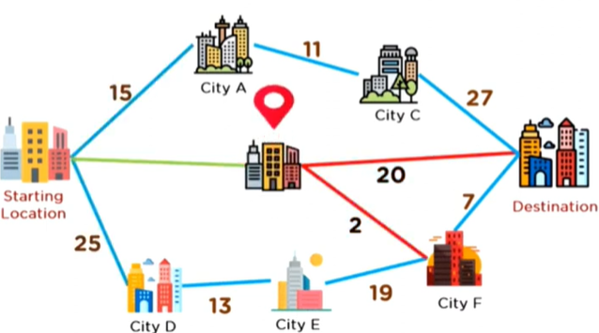
What is a Search Algorithm?
A search algorithm is a kind of algorithm used in artificial intelligence that explores a set of potential solutions, also known as a search space, in order to discover the best or most optimum solution to a problem.
To identify the optimum answer for a given set of constraints, a search algorithm sorts through a vast number of options.
Generally, search algorithms work by arranging the search space into a specific kind of graph, which is usually a tree, and then calculating the optimal score, or cost, of going through each branch of the tree.
A path that maximizes the cost within the constraints of the implemented method from the start state to the goal state is called a solution.

Slide 6
Components of a Search Problem
State/Search Space
The set of all possible states the system can be in. Each state represents a specific configuration or situation of the problem
Initial/Start State
It is a state from where an agent begins the search.
Goal State
The desired state/condition that the system aims to reach. The objective of the search is to find a sequence of actions that lead from initial state to the goal state
Operators/Actions
The set of actions or operators that the system can perform to transition from one state to another. (building blocks of the search process)
Transition model
Describes how the system moves from one state to another when a specific action is applied.
Path Cost
The cost associated with taking a specific path. The goal is to find the path with minimum cost

Slide 7
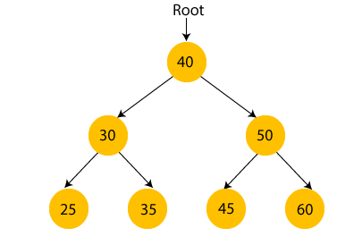
Other Terms
Search tree: A tree representation of search problem. The root of the search tree is the root node which is corresponding to the initial state.
Time and space complexity are measured in
‘b‘ – maximum branching factor of the search tree.
‘d‘ – the depth of the least-cost solution.
‘m‘ – maximum depth of the state space(maybe infinity)
Solution: It is an action sequence which leads from the start node to the goal node.
Optimal Solution: If a solution has the lowest cost among all solutions.

Slide 8
ROBOTIC LAWN MOWER PROBLEM
Define the problem
Create a search space with states and actions
Employ search algorithms
Consider heuristics and optimization criteria
Adapt to a dynamic environment, possibly with a learning mechanism

Slide 9
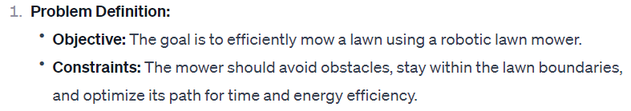
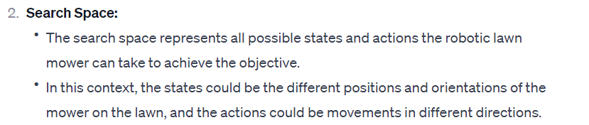
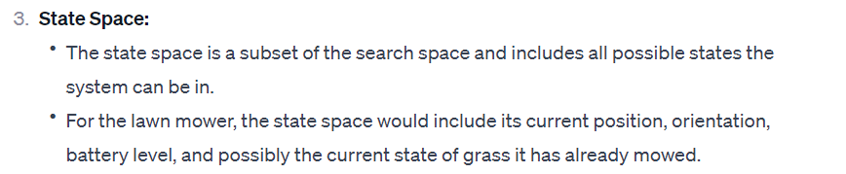
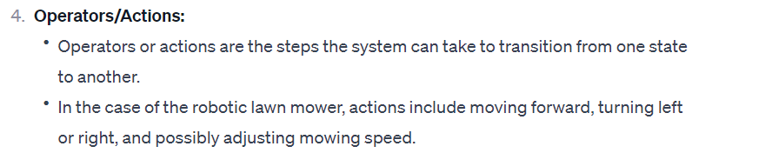

Slide 10
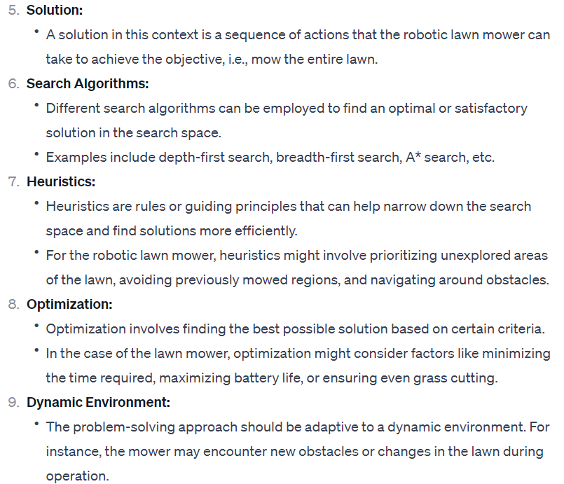
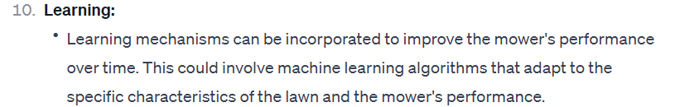

Slide 11
4 Essential Properties of Search Algorithms
Completeness: A search algorithm is said to be complete if it guarantees to return a solution if at least any solution exists for any random input
Optimality: If a solution found for an algorithm is guaranteed to be the best solution (lowest path cost) among all other solutions, then such a solution for is said to be an optimal solution.
Time Complexity: Time complexity is a measure of time for an algorithm to complete its task.
Space Complexity: It is the maximum storage space required at any point during the search, as the complexity of the problem.

Slide 12
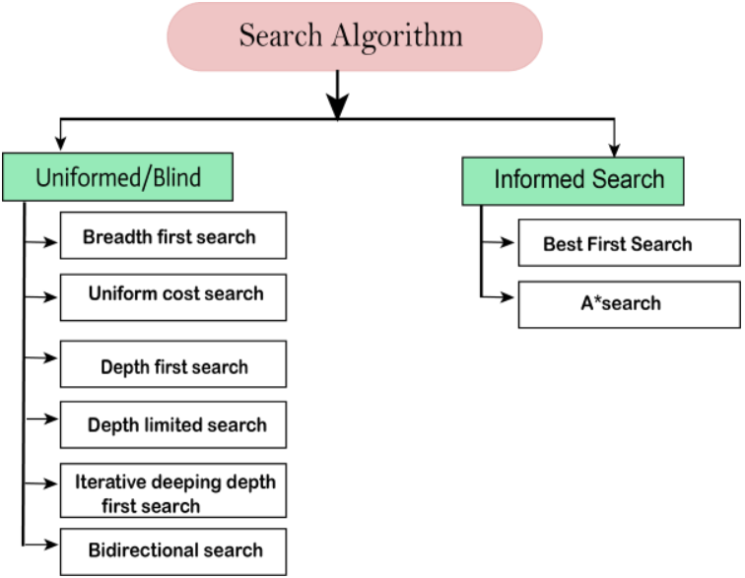
Notes:
Uninformed Search: Algorithms that are general purpose traversals of the state space or search tree without any information about how good a state is. These are also referred to as blind search algorithms.
Informed Search: Algorithms that have information about the goal during the traversal, allowing the search to prioritize its expansion toward the goal state instead of exploring directions that may yield a favorable cost but don’t lead to the goal, or global optimum. By including extra rules that aid in estimating the location of the goal (known as heuristics) informed search algorithms can be more computationally efficient when searching for a path to the goal state.

Slide 13
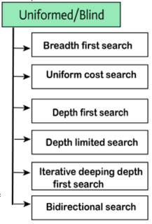
What is Uninformed Search in AI?
Aka blind search : an algorithm that explores a problem space (produces the search tree ) without any domain knowledge or information about the problem other than the initial state and the possible actions to take.
The machine blindly follows the algorithm regardless of whether right or wrong, efficient or in-efficient. (it’s brute force in nature)
They systematically explore the search space for all possible solutions of the problem by applying predefined rules to generate successor states until a goal state is found or the search is exhausted.
They are less efficient than informed search algorithms.
They are used in various applications, ranging from game playing to route planning and problem-solving

Slide 14
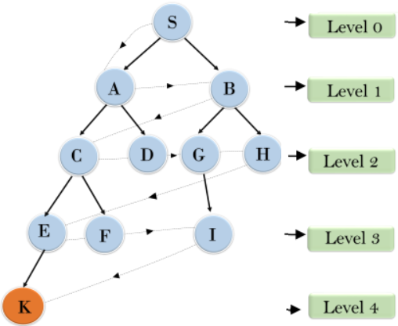
Breadth-First Search (BFS)
Exploration Strategy: Explores the search space level by level, visiting all nodes at the current level before moving on to the next level.
Memory Usage: Requires more memory as it needs to store all nodes at the current level.
Completeness: Guarantees finding the shallowest solution, making it complete if the branching factor is finite.
Optimality: Finds the optimal solution in terms of the number of steps but not necessarily in terms of cost.

Slide 15
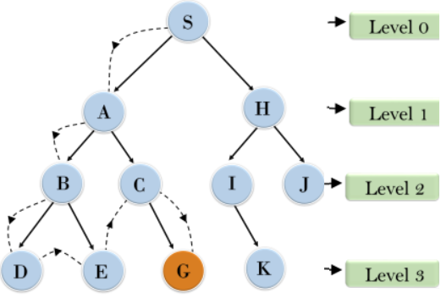
Depth-First Search (DFS)
Exploration Strategy: Explores as far as possible along one branch before backtracking.
Memory Usage: Uses less memory compared to BFS, as it only needs to store the nodes along the current path.
Completeness: May not be complete if the search space has infinite depth or loops.
Optimality: Does not guarantee finding the optimal solution in terms of the number of steps or cost.

Slide 16
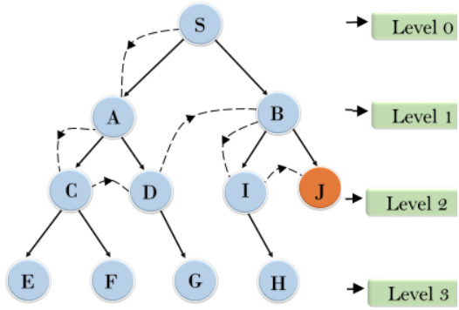
Depth-Limited Search (DLS)
Exploration Strategy: Similar to DFS but with a depth limit, preventing it from going too deep into the search space.
Memory Usage: Uses less memory compared to DFS but may still require significant memory for deep searches.
Completeness: Complete if the depth limit is greater than or equal to the depth of the optimal solution.
Optimality: May not find the optimal solution if the depth limit is too shallow.

Slide 17
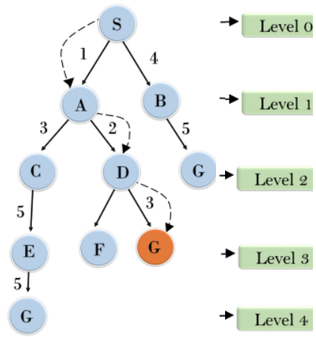
Uniform-Cost Search (UCS)
Exploration Strategy: Explores the least-cost path first, prioritizing nodes with lower path costs.
Memory Usage: Can use a significant amount of memory, especially in scenarios with high path costs.
Completeness: Complete if the step cost is greater than or equal to some small positive value and the solution exists.
Optimality: Guarantees finding the optimal solution in terms of cost.

Slide 18
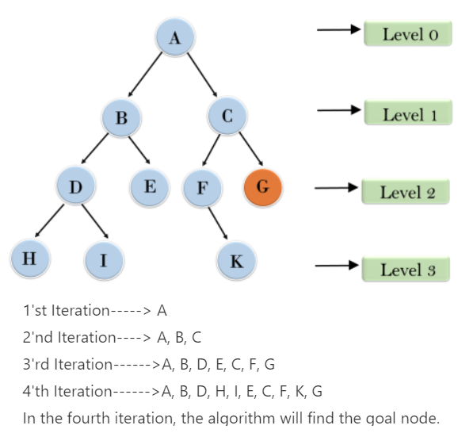
Iterative deepening depth-first Search

Slide 19
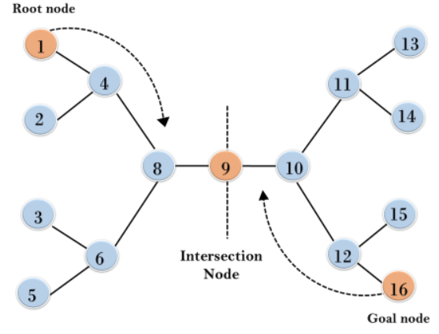
Bidirectional Search Algorithm
Completeness: Bidirectional Search is complete if we use BFS in both searches.
Time Complexity: Time complexity of bidirectional search using BFS is O(b^{d}).
Space Complexity: Space complexity of bidirectional search is O(b^{d}).
Optimal: Bidirectional search is Optimal.

Slide 20
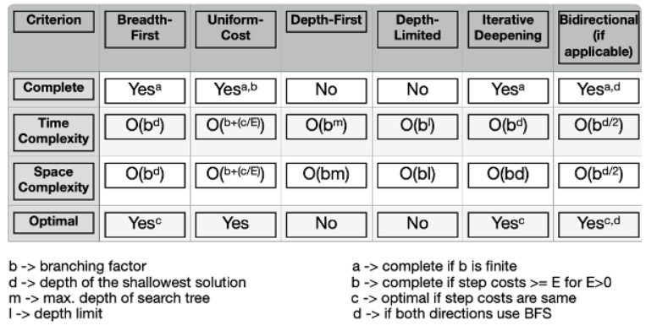
Summary

Slide 21
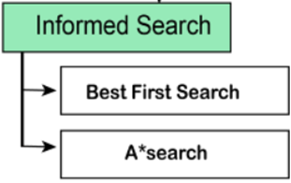
What is Informed Search in AI?
AKA heuristic search: it use additional knowledge or heuristics to guide the search process
Examples of additional knowledge: how far we are from the goal, path cost, how to reach to goal node, etc.
This knowledge help agents to explore less to the search space and find more efficiently the goal node. (more useful for large search space)
Heuristic is a function h(n) in Informed Search, used to find the most promising path.
It takes the current state of the agent as its input and produces the estimation of how close agent is from the goal.

Slide 22
Best-first Search Algorithm (Greedy Search)
Time Complexity: The worst case time complexity of Greedy best first search is O(b^{m}).
Space Complexity: The worst case space complexity of Greedy best first search is O(b^{m}). Where, m is the maximum depth of the search space.
Complete: Greedy best-first search is also incomplete, even if the given state space is finite.
Optimal: Greedy best first search algorithm is not optimal.

Slide 23
A* Search Algorithm
A* search is the most commonly known form of best-first search.
It uses heuristic function h(n), and cost to reach the node n from the start state g(n).
A* algorithm returns the path which occurred first, and it does not search for all remaining paths.
The efficiency of A* algorithm depends on the quality of heuristic.
A* algorithm expands all nodes which satisfy the condition f(n)

Slide 24
Key Features of Informed Search

Slide 25
Applications of Search Algorithms
Pathfinding: finding the shortest path between two points.
Dijkstra's algorithm or A* (A-star)
Scheduling Tasks efficiently: find an optimal schedule that minimizes the overall completion time.
Game theory: enable players or AI agents to analyze potential moves, evaluate outcomes, and make informed decisions.
Notes:
Finding the Shortest Path between Two Points: Whether it's navigating through a city or planning a delivery route, algorithms such as Dijkstra's algorithm or A* (A-star) can efficiently determine the optimal path. These algorithms explore the graph representation of the problem space, considering the cost associated with each path and gradually moving toward the destination. By leveraging these algorithms, we can save time, and resources, and improve efficiency in various transportation and logistics scenarios.
Scheduling tasks efficiently is a critical challenge in many domains, such as project management or resource allocation. By formulating task scheduling as a search problem, we can employ search algorithms to find an optimal schedule that minimizes the overall completion time. These algorithms explore the search space of possible task sequences, considering factors such as dependencies, deadlines, and resource constraints. By incorporating techniques like constraint satisfaction or heuristic-based search, we can develop effective scheduling solutions tailored to specific contexts.
Mazes, whether on paper or digital platforms, can be transformed into graph structures. Search algorithms prove invaluable in solving mazes by exploring paths and identifying the route from the starting point to the end. By applying algorithms like depth-first search (DFS) or breadth-first search (BFS), we can efficiently navigate through intricate mazes, map out the solution, and uncover hidden paths. This technique finds applications in areas such as game design, automated robotic navigation, and architectural planning.

Slide 26
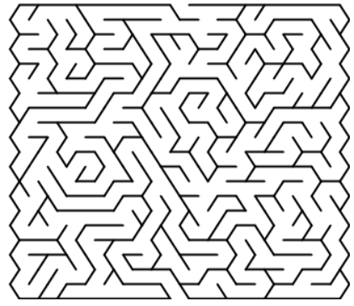
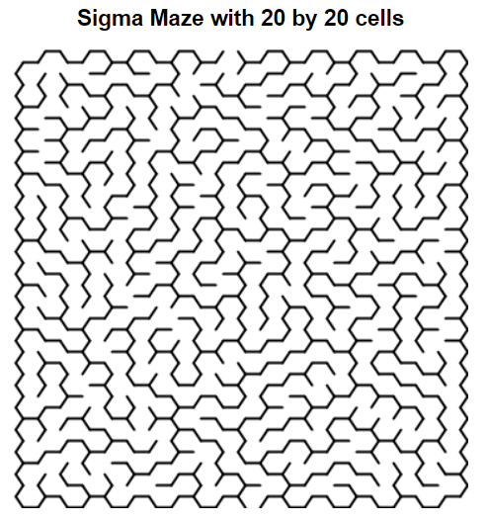
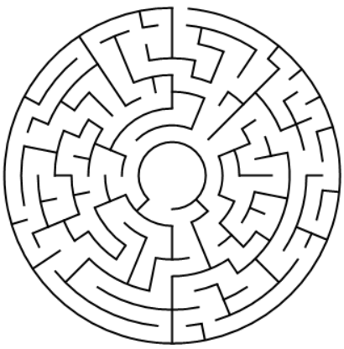

Slide 27
References
https://www.youtube.com/watch?v=OmOwj3qMdOY
https://angeluriot.com/maze_solver/
Top 5 Most Common Graph Algorithms for Coding Interviews (youtube.com)
Breadth First Search (BFS): Visualized and Explained (youtube.com)
Depth First Search (DFS) Explained: Algorithm, Examples, and Code (youtube.com)

